Slide 1
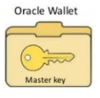




Database Connectivity
TCPS Components
Database Server
TCPS/TCP

Slide 2

Database connectivity with TCPS

